Slide 1
C Programming
Short Notes

Slide 2
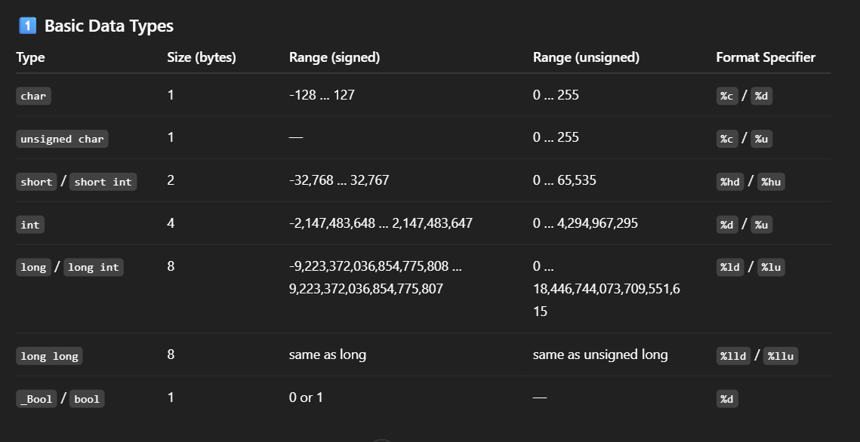

Slide 3
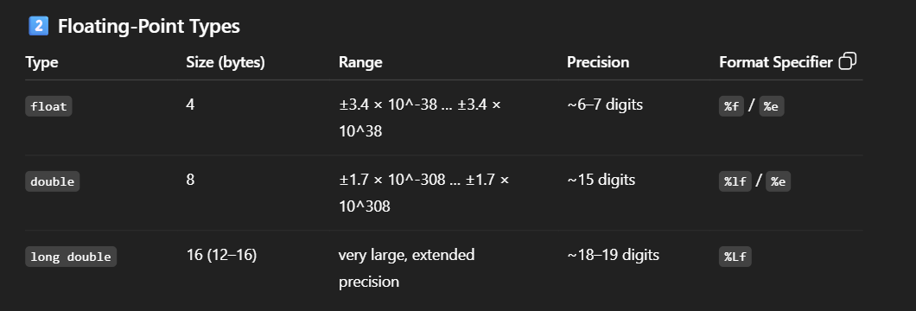

Slide 4
